Slide 1
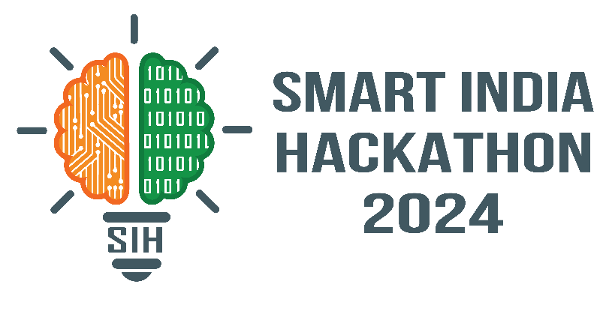
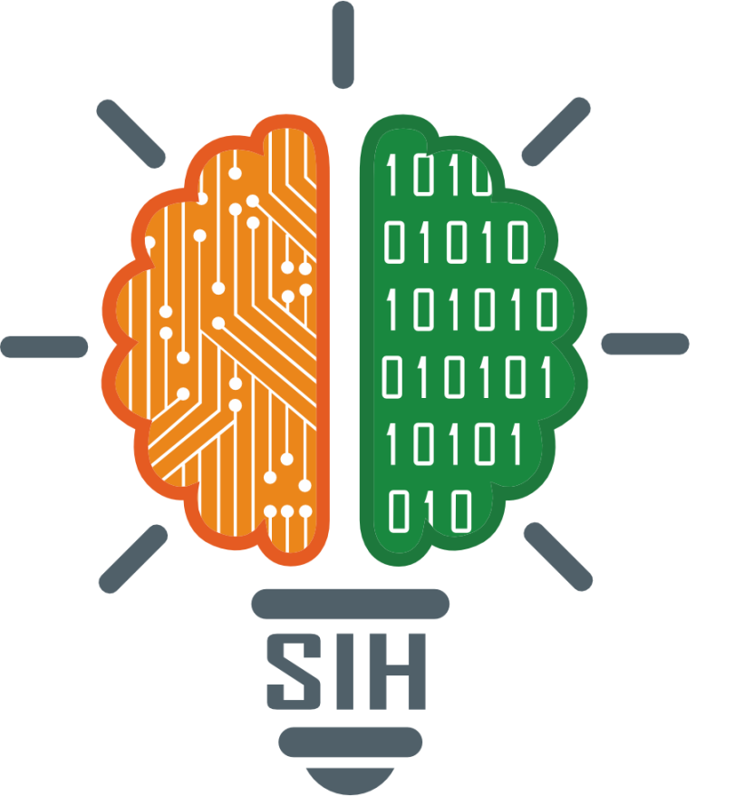
SMART INDIA HACKATHON 2024
TITLE PAGE
Problem Statement ID – SIH1638
Problem Statement Title- AI-Driven Crop Disease
Prediction and Management System.
Theme- Agriculture, FoodTech & Rural Development
PS Category- Software
Team ID-
Team Name (Registered on portal)- TEAM ZENESIS

Slide 2
IDEA TITLE
TEAM ZENESIS
The platform will be used to improve plant health and productivity by using AI-driven platform that analyze images and identifies common plant disease or pests based on visual symptoms.
Image capture : Allows users to take photos of plants and leaves.
Disease and Pest Recognition : Uses AI to analyze images and identify common plant diseases or pests based on visual symptoms.
Diagnosis and Recommendations : Provides diagnosis along with suggested treatments or actions to address the identified issue.
Plant Database : Contains a comprehensive database of plants, diseases, and pests to improve recognition accuracy.

Slide 3
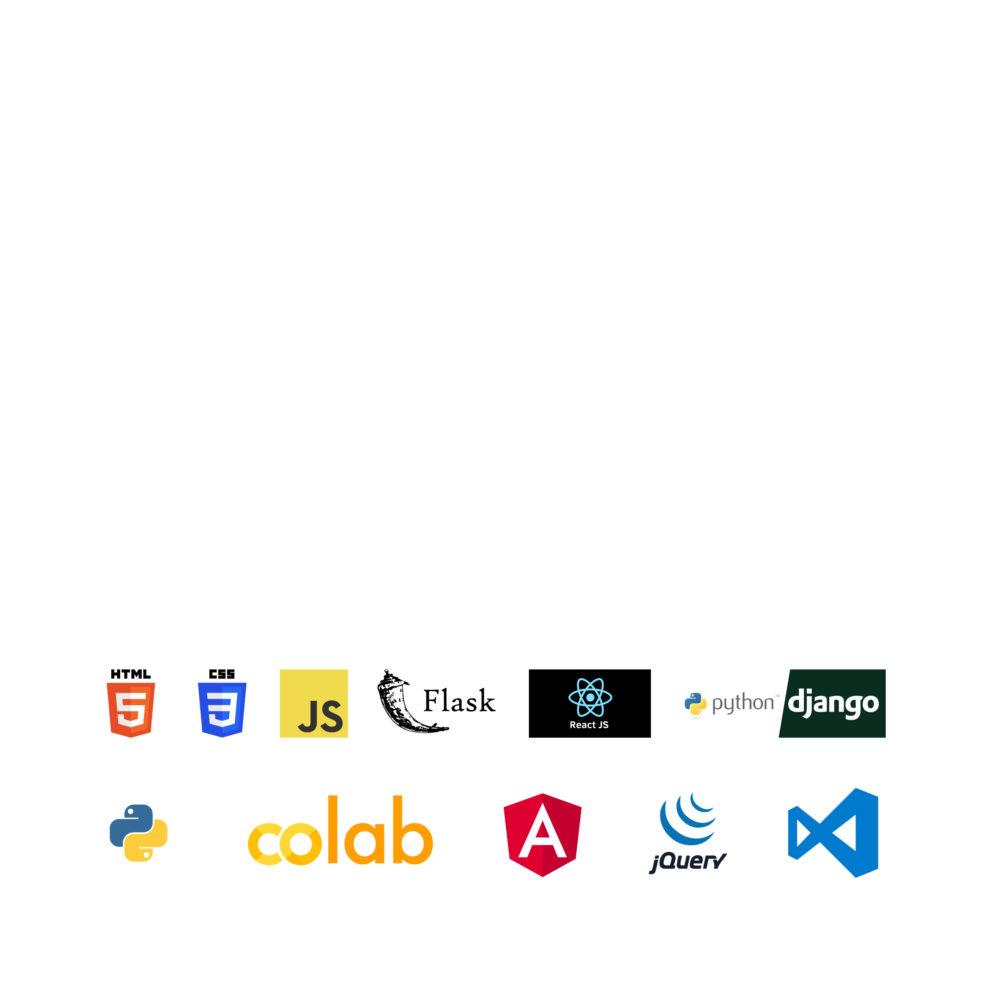
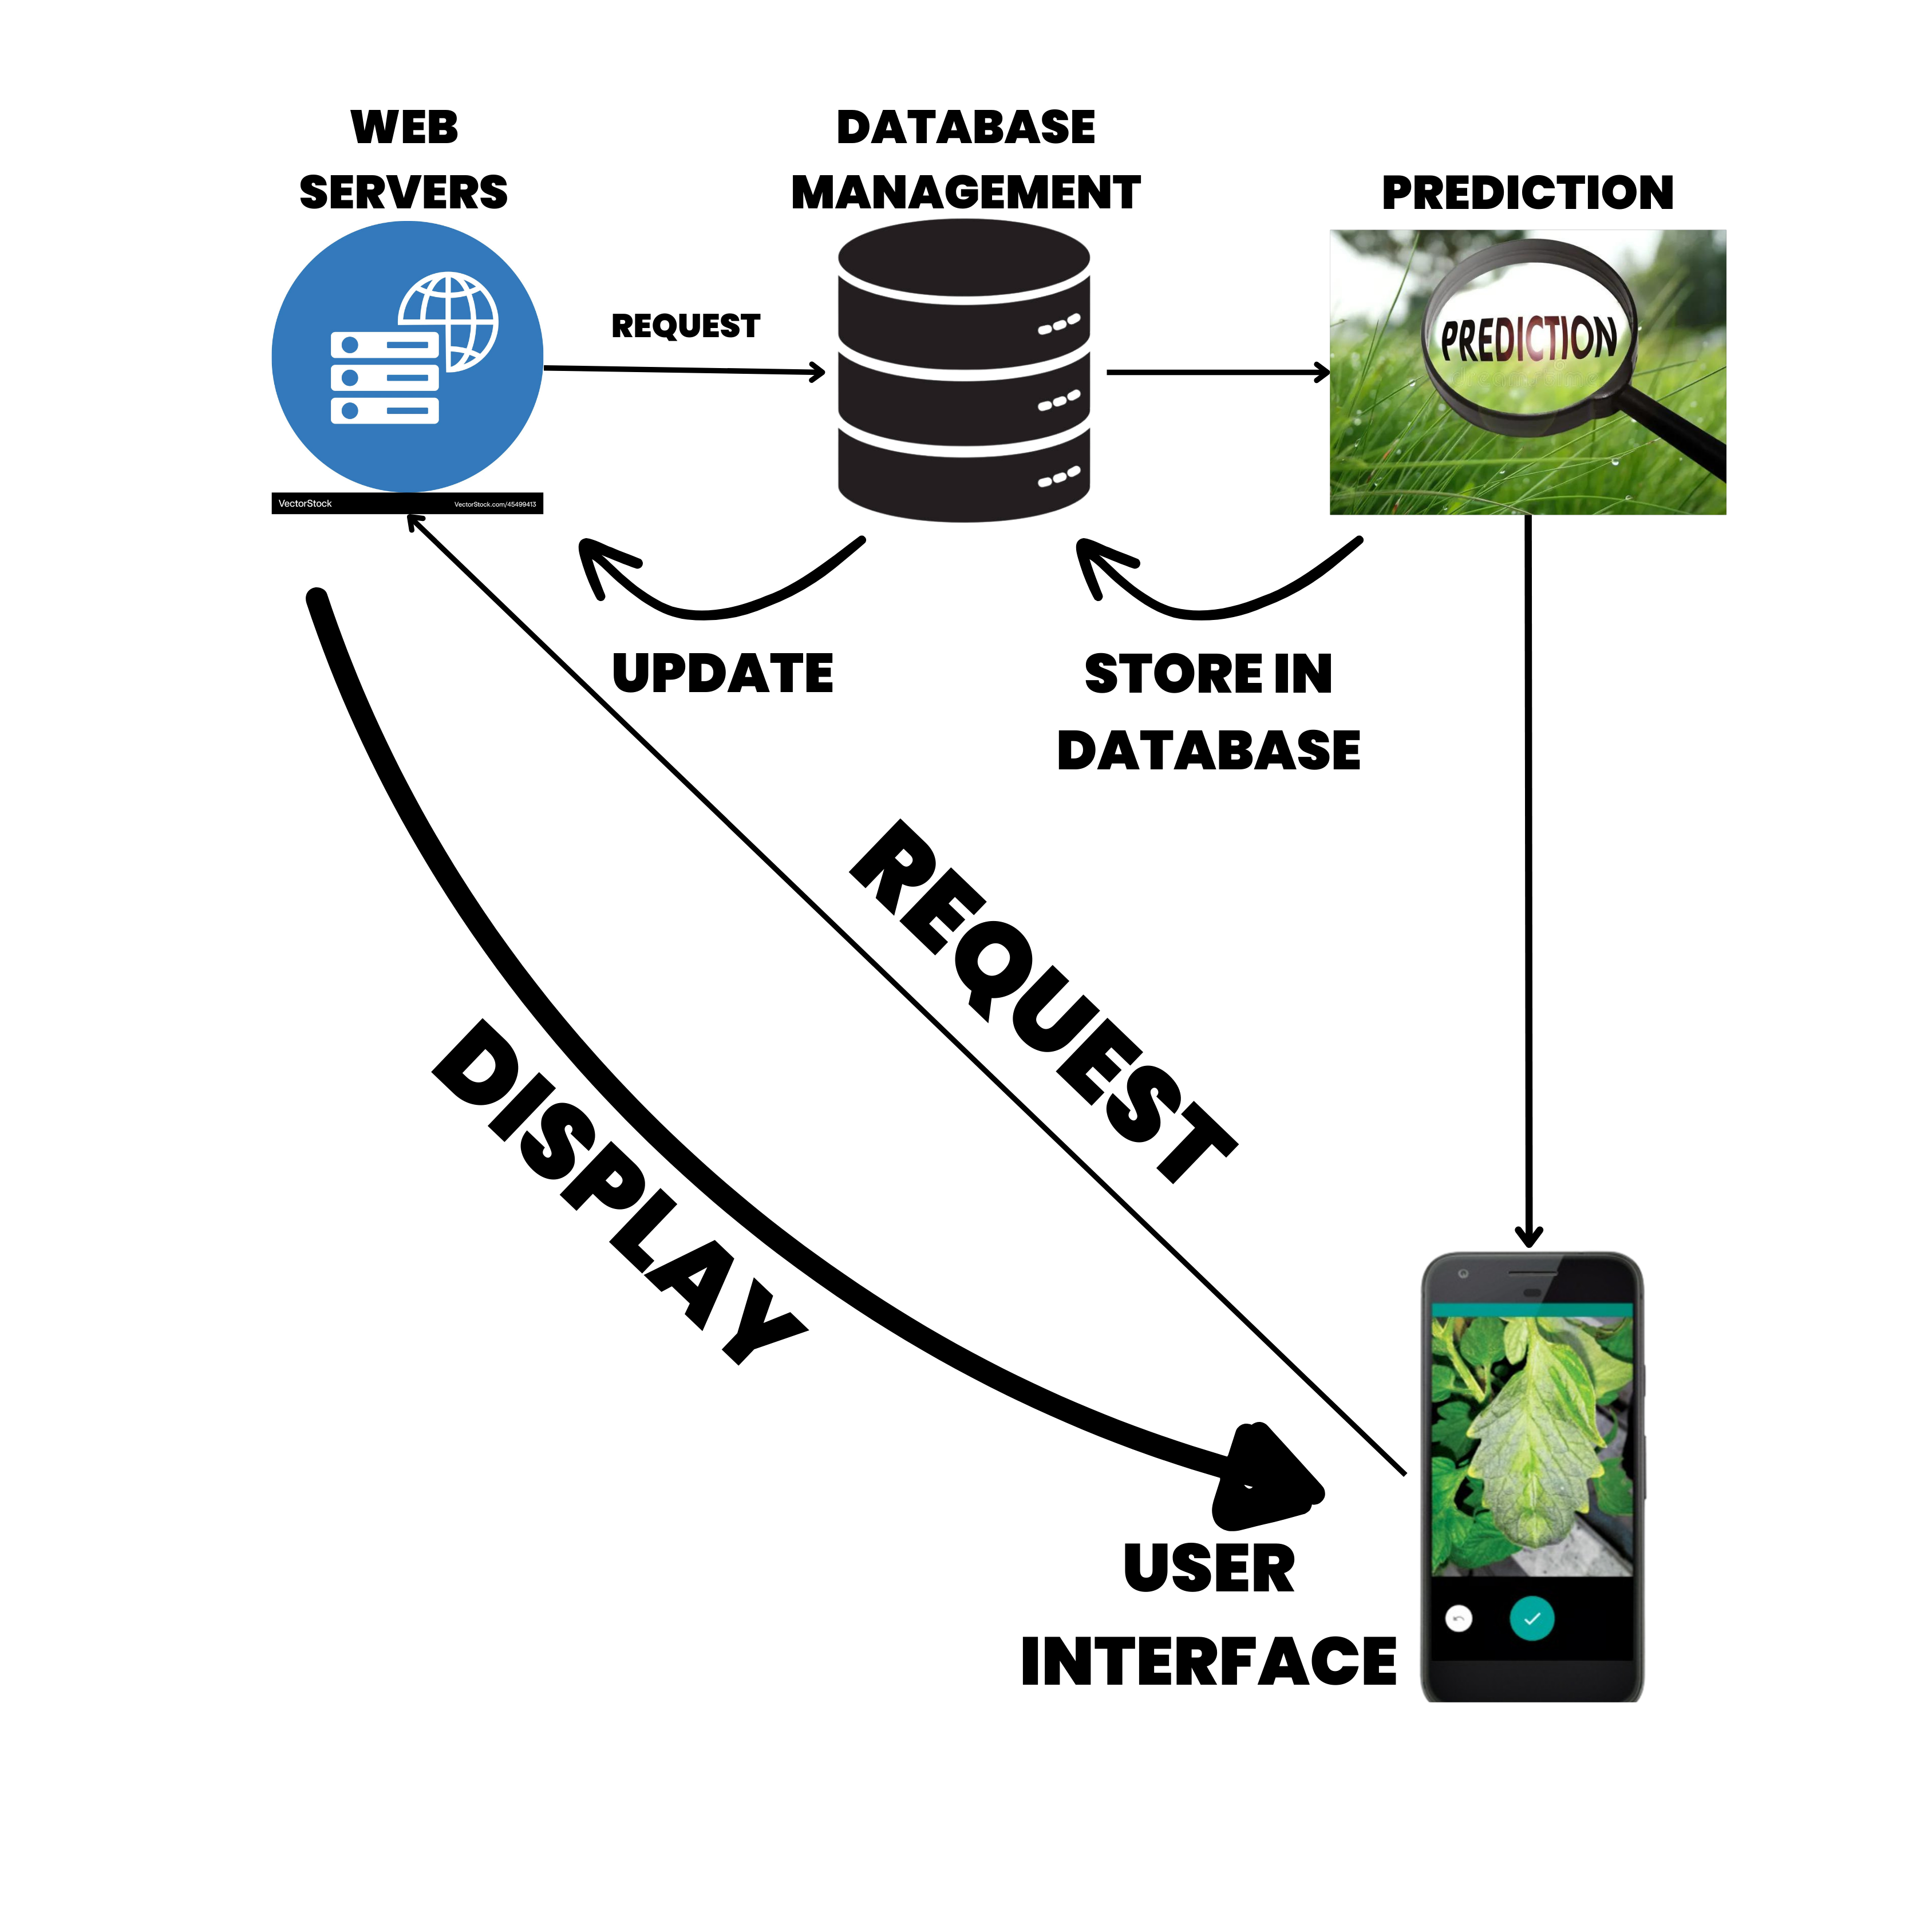
TECHNICAL APPROACH
TEAM ZENESIS
Frontend: HTML, CSS, JavaScript (React or Angular can enhance the experience).
Backend: Python with Flask/Django , Numpy , pandas , werkzeug , Node JS and other libraries and API.
Deep Learning: Convolutional Neural Networks (CNN) for image recognition of plant diseases. Pre-trained models like ResNet, MobileNet can help fast-track development and TENSERFLOW is used too.
Database: Store user data and prediction results in a MongoDB or PostgreSQL database. Cloud Integration: Use AWS/Azure/Google.

Slide 4
FEASIBILITY AND VIABILITY
TEAM ZENESIS
Data Availability: AI models require large datasets (soil conditions, crop health, weather, pests) for accurate disease prediction.
Crops Covered: AI can be trained for disease prediction across various crops (wheat, rice, corn, fruits, vegetables), with adaptability to local data.
Accessibility for Small Farmers: Affordability is a challenge; potential solutions include government subsidies, cooperative ownership, or software-as-a-service models.
Technical Issues: Connectivity, system integration, and model reliability are key challenges, especially in diverse regions.
Costs: High initial investment, maintenance, and uncertain ROI may deter adoption, particularly by small-scale farmers.
To overcome the challenges of implementing our platform, consider these strategies:
Improve Data Quality: Partner with local agricultural institutions to gather high-quality, region-specific data and improve model accuracy.
Affordable Access: Offer government subsidies, co-op models, or subscription-based services to reduce initial costs for small farmers.
Farmer Training: Provide user-friendly interfaces, ongoing training programs, and local support to improve technological adoption and understanding.
Government Collaboration: Work with policymakers to develop regulations that support the use of AI in agriculture and ensure compliance with local laws.

Slide 5
IMPACT AND BENEFITS
TEAM ZENESIS
The potential impact of our platform on the target audience (farmers, agricultural workers, and stakeholders) includes:
Increased Productivity: Farmers can experience more consistent and higher crop yields, improving their livelihoods and economic stability.
Improved Decision-Making for Farmers: AI predictions can help farmers make informed, data-driven decisions about disease prevention, leading to healthier crops and better yields.
Reduced Financial Burden: With accurate disease predictions, farmers can avoid excessive use of pesticides, lowering their operational costs and increasing profits.
The benefits of our platform include:
Early Disease Detection: Enables farmers to take preventive actions before diseases spread, reducing crop loss.
Resource Optimization: Reduces overuse of pesticides, water, and fertilizers, lowering costs and environmental impact.
Reduced Pesticide Use: With precise disease predictions, farmers can apply pesticides only when and where needed.
Improved Crop Yield and Quality: By predicting and managing diseases effectively, AI-driven systems help maintain healthy crops, leading to higher yields and better-quality produce.

Slide 6
RESEARCH AND REFERENCES
TEAM ZENESIS
1. Official Resources:- [Smart India Hackathon Website](https://www.sih.gov.in/) for guidelines and problem statements.
2. Research Papers:- Use [Google Scholar](https://scholar.google.com), [IEEE Xplore](https://ieeexplore.ieee.org), and [ResearchGate](https://www.researchgate.net) for academic research.
3. Government Data:- Explore [NITI Aayog](https://www.niti.gov.in) and [Data.gov.in](https://data.gov.in) for relevant statistics and reports.
4. Tech Blogs:- Check [Medium](https://www.medium.com), [TechCrunch](https://www.techcrunch.com), and [Devpost](https://www.devpost.com) for trends and case studies.
5. Patent Databases:- Search [Google Patents](https://patents.google.com)

